Slide 1
Advanced C++
Chapter 11 - Operator Overloading – Part 2
Spring 2011
Kristina Shroyer

Slide 2
Converting Between Types
Casting (conversion)
  Traditionally, cast integers to floats, etc.
  May need to convert between user-defined types
The cast operator can be overloaded (conversion operator)
  Convert from
    One class type to another class type
    A class type to a built-in type (int, char, etc.)
  Must be non-static member function
  Do not specify return type
    Implicitly returns type to which you are converting

Slide 3
Converting Between Types
There are two ways to convert between non-fundamental (non-primitive) types in C++
  With a conversion constructor
    This is a single argument constructor that turns the argument (which could be a primitive (fundamental) type or a class type) into an object of a particular class
      Any constructor with one parameter is a conversion constructor
    So this constructor does two things:
      It creates instances of a class as normal
      It also provides the compiler with a way of performing implicit type conversions.
        Whenever a value of the constructor's parameter type is given where the class type is expected this conversion constructor will be implicitly called to perform the conversion
  With an overloaded conversion operator (cast operator)
    This would be an explicitly overloaded cast operator (must be done if not working with fundamental types and not using a conversion constructor)
IMPORTANT NOTE: When necessary the C++ compiler will implicitly call the conversion constructor or the overloaded conversion operator (overloaded cast operator) to create temporary objects in order to be able to work with the correct type of the class
  EXAMPLE: Suppose the code is in place for an object of class String to be be cast to char * (it could be a conversion constructor OR a overloaded conversion operator)
  cout << s; // s is a String
    Compiler implicitly converts s to char * for output
    Do not have to overload << in this case, this would only be true if the cast operator was overloaded for converting String to char* (either implicitly – conversion constructor or explicitly – overloaded cast operator)

Slide 4
Converting Between Types
Explicitly overloading the cast operator
  Example – casting a String temporarily into a char*
    Prototype in class String:
      operator char *() const;
    This code declares an overloaded cast operator function for converting an object of class type String into a temporary char* object (remember a char* is a pointer to an array of chars…a C-String)
    So once implemented this function casts class String to a temporary char *
    The function is declared const because it should NOT modify the original object (it just converts it temporarily…remember casts from your entry level classes)
    The function does not specify a return type not even void because the return type is automatically the type to which the object is being converted
    static_cast< char * >( s ) or char *(s) or (char*)s calls
    s.operator char *()
  Overloaded cast operator functions can also convert objects of user defined (class) types into objects of fundamental types or other user defined types – see prototypes below for class type String:
    operator int() const;
    operator OtherClass() const;
Conversion constructors and casting can prevent need for overloading
  Suppose class String can be cast to char *
  cout << s; // s is a String
    Compiler implicitly converts s to char * for output
    Do not have to overload <<

Slide 5
Building a String Class
Let's say the C++ string class didn't exist and we wanted to build our own String class that simplified C-Style strings (arrays of chars) by having a simple String representation with simple functions that could be called to act on the String class instance without the programmer having to worry about allocating memory like they do with C-Strings
  So basically this class would wrap up the complexities of C-Strings in a class data type (this is what the real string class does btw)
  This String class would have a conversion constructor
Our String class's private members:
  private:
  int length; //string length not counting the null terminator
  char *sPtr; //pointer to a char array (C String)
  //private utility function
  void setString(const char*);

Slide 6
Building a String Class
Later on I've posted the entire example for this new String class but for now I just want to look at the conversion constructor
Prototype for a conversion constructor for the String class
  String(const char* = "");
Conversion Constructor definition
  String::String(const char* s):length((s!=0) ? strlen(s):0)
  {
  setString(s); //call the private utility functino
  }
private utility function setString(s) definition
  void String::setString(const char* string2)
  {
  sPtr = new char[length + 1]; //allocate memory including extra space for
  //null terminator
  if(string2 != 0) //0 is equivalent to null, if it's not pointing to
  //nothing
  {
  strcpy(sPtr, string2); //copy literal into object (sPtr is data member)
  }
  else
  {
  sPtr[0] = '\0'; //for the empty string
  }
  }

Slide 7
Building a String Class
All of the following code would implicitly call the conversion constructor of the String class shown on the previous slide
  String myString;
  myString = "hello";
    Remember from CSIS 135 that "hello" is a C-String literal, so it must be converted for this to work
  String s1("hello");
  if there are any functions in the String class that take String types as arguments, and the code passes in a char* (C-String), the automatic conversion will be done by calling the conversion constructor and creating a temporary String instance (so the constructor will be called for the temporary operation in the member function and then be destroyed when the function terminates…due to the lifetime of parameter variables/objects)

Slide 8
Building a String Class - Example
Example 3a
  This is an example with a conversion constructor and an explicitly overloaded conversion operator
  Let's look at this in detail because I think the book did a poor job of explaining the conversion constructor and the explicit overload operation for casting

Slide 9
Back to our Array Class
Question: Does our Array class from the part 1 slides have a conversion constructor?

Slide 10
Overloading ++ and --
Both the prefix and postfix versions of ++ and -- can be overloaded
  Remember everything must be overloaded explicitly so if you want both the prefix and postfix ++ and -- overloaded for your class it must be done explicitly by writing overloaded functions for each
Overloading prefix ++ and --
  These are overloaded as any unary operator would be
  So if we had a Date class and we wanted to overload the prefix ++ as a member function:
    our prototype would look like this:
      Date& operator++();
    a function call might look like this:
      Date date1;
      ++date1; //this would call our overloaded member function
        The function call would look like: date1.operator++();
  Overloading the same Date class prefix ++ as a global function
    our prototype would look like this:
      Date& operator++(Date&);
    a function call might look like this:
      Date date1;
      ++date1; //this would call our overloaded member function
        The function call would look like: operator++(date1);

Slide 11
Overloading ++ and -- (postfix)
The issue that comes up with overloading the postfix operator
  The problem is our overloaded functions have to have a way of distinguishing whether or not they are overloading the prefix ++ or the postfix ++
The convention C++ has adopted for this is that when the compiler sees a postfix expression like date1++ it generates the member function call: date1.operator++(0);
  The prototype for the postfix overloaded member function called above is:
    Date operator++(int);
  The argument 0 is a dummy value that has only one purpose which is to distinguish between the postfix and prefix increment and decrement calls
  Example if the postfix ++ is overloaded as a member function
    Function prototype: Date operator++(int);
    Date date1;
    date1++;
    Function call: date1.operator++(0)
  Example if the postfix ++ is overloaded as a global function
    Function prototype: Date operator++(Date&, int);
    Date date1;
    date1++;
    Function call: operator++(date1,0)

Slide 12
Overloading ++ and – postfix vs. prefix
Notice that:
  the prefix operator returns Date objects by reference (Date& ) and
  the postfix operator returns Date objects by value
With postfix, the operator returns a temporary object that contains the original value of the object before the increment occurred
  These type of objects cannot be used on the right side of the assignment operator
With prefix the operator returns a reference to the incremented object with its new value
  These type of objects can be used on the right side of the assignment operator

Slide 13
Performance Tip 11.3
The extra object that is created by the postfix increment (or decrement) operator can result in a significant performance problem—especially when the operator is used in a loop.
  For this reason, you should use the postfix increment (or decrement) operator only when the logic of the program requires postincrementing (or postdecrementing).

Slide 14
Case Study: A Date Class – Example 4
Example Date class
  Overloaded increment operator ++ (both prefix and postfix)
    Change day, month and year
  Overloaded += operator
  Function to test for leap years
  Function to determine if day is last of month

Slide 15
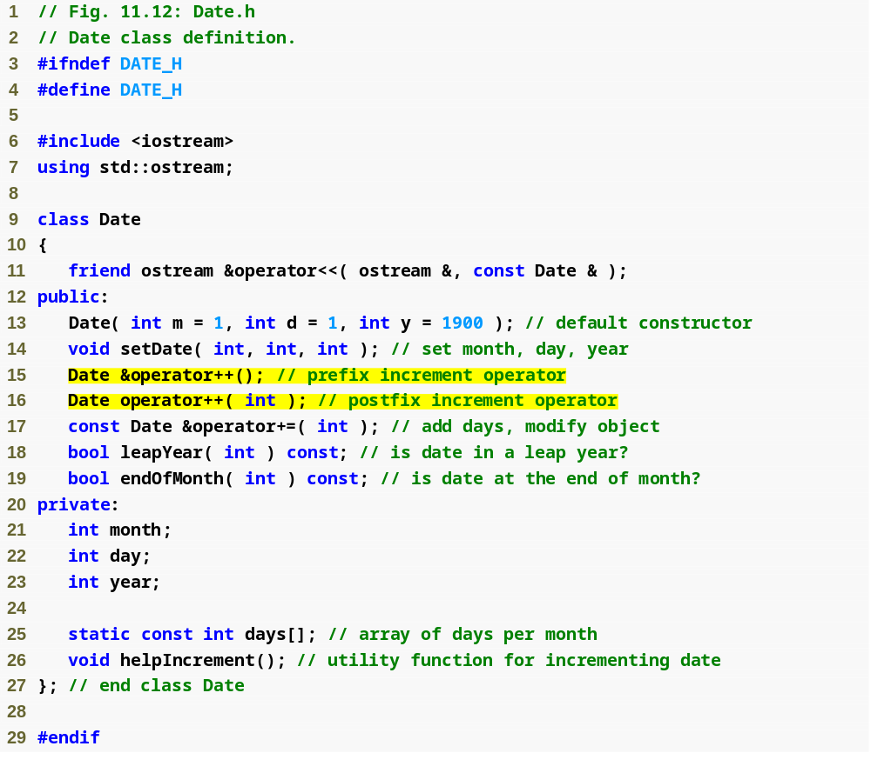
Example 4
Date.h
(1 of 1)
Note the difference between prefix and postfix increment

Slide 16
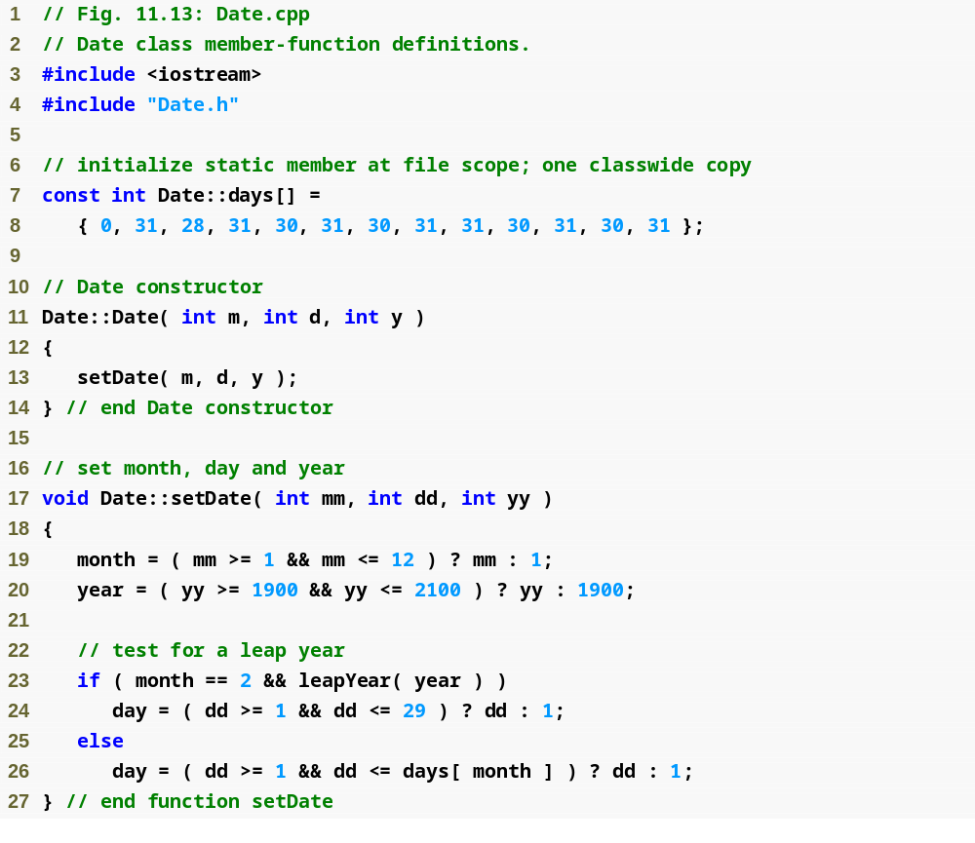
Example 4
Date.cpp
(1 of 4)

Slide 17
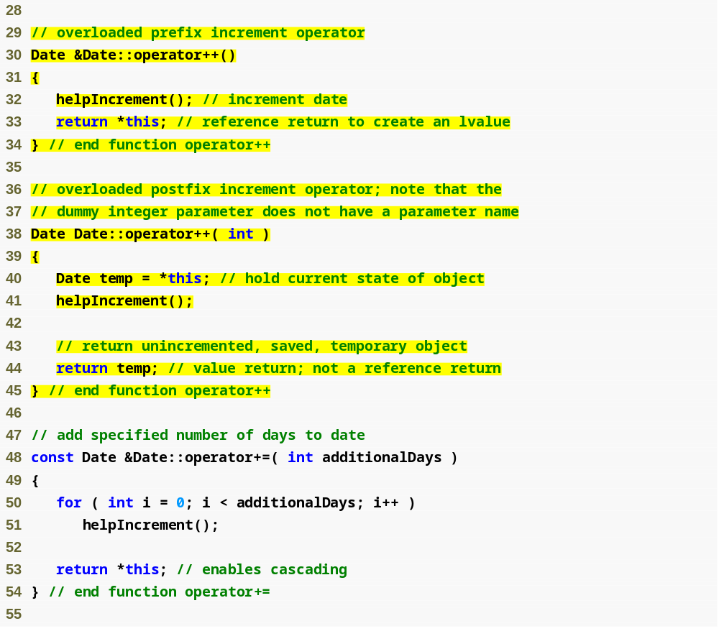
Example 4
Date.cpp
(2 of 4)
Postfix increment updates object and returns a copy of the original
Do not return a reference to temp, because it is a local variable that will be destroyed

Slide 18
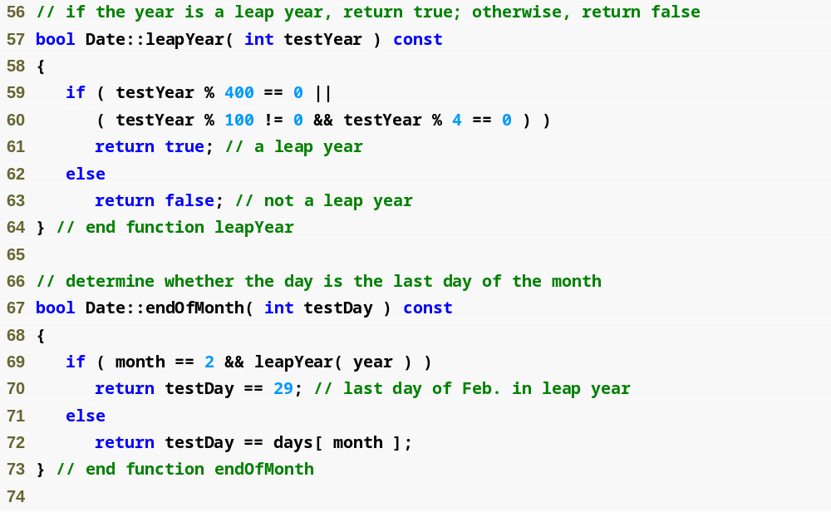
Example 4
Date.cpp
(3 of 4)

Slide 19
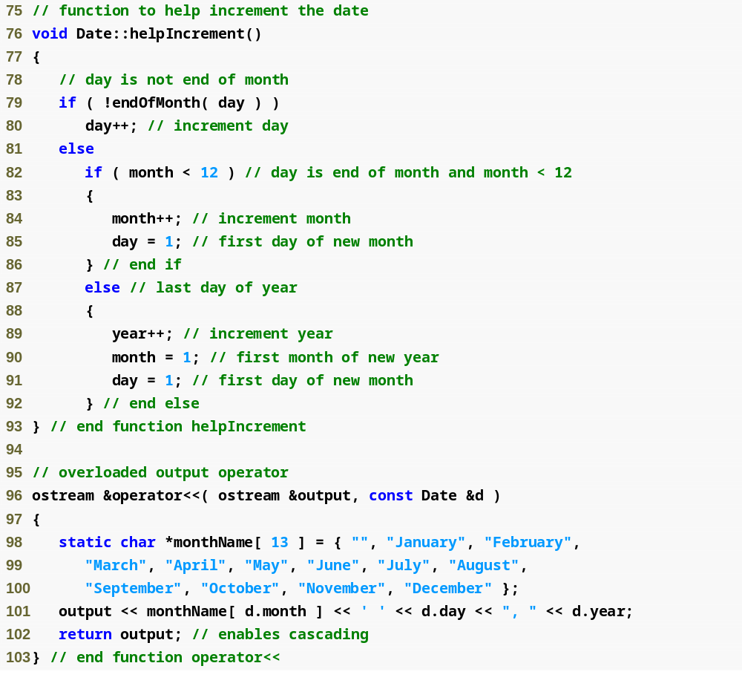
Example 4
Date.cpp
(4 of 4)

Slide 20
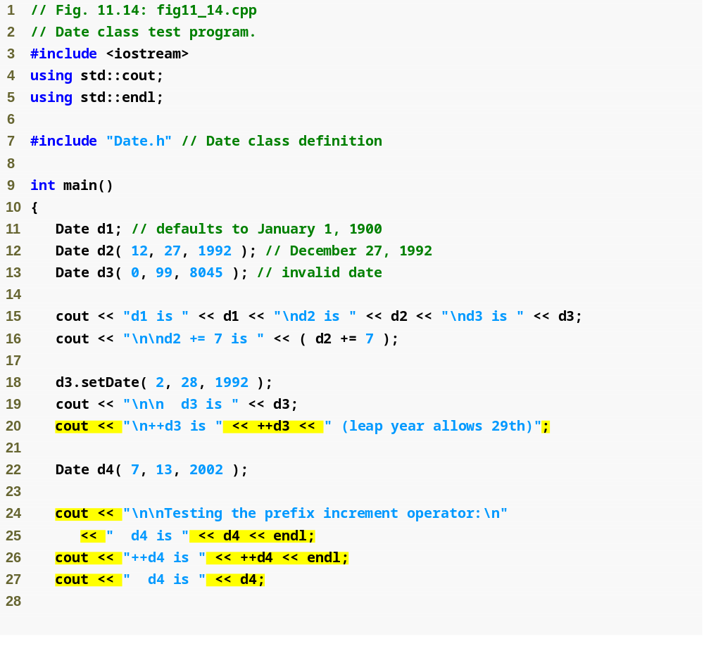
Example 4
test4.cpp
(1 of 2)
Demonstrate prefix increment

Slide 21
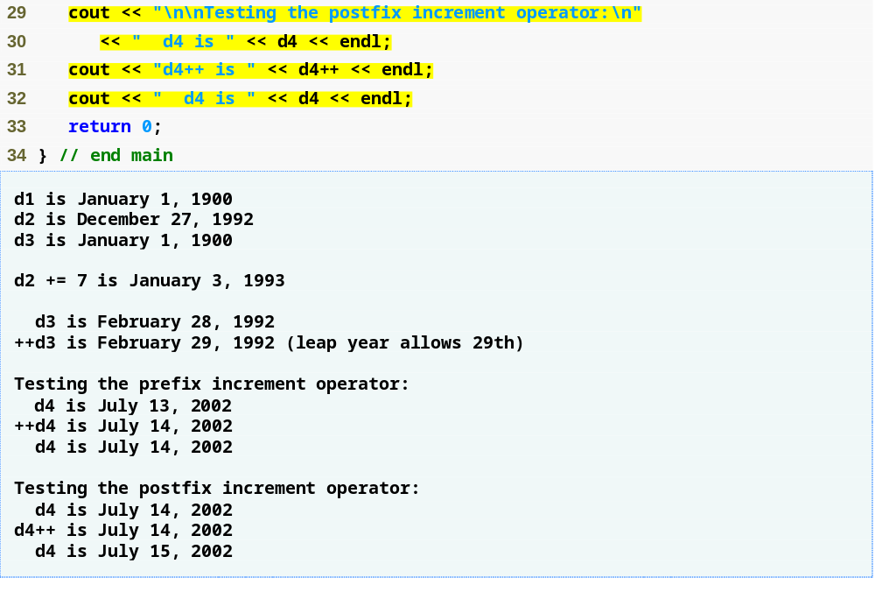
Demonstrate postfix increment
Example 4
test4.cpp
(2 of 2)

Slide 22
Standard Library Class string
Class built into C++
  Available for anyone to use
  Class string
    Similar to the String class we started talking about earlier and that I implemented a full example of that you can go through later on your own
Class string
  Header <string> , namespace std
  Can initialize string s1( "hi" );
  Overloaded << (as in cout << s1)
  Overloaded relational operators
    ==, !=, >=, >, <=, <
  Assignment operator =
  Concatenation (overloaded +=)

Slide 23
explicit Constructors
Implicit conversions are
  Performed by compiler using single-argument constructors (conversion constructors)
  Sometimes, implicit conversions are undesirable or error-prone
    Keyword explicit
      Suppresses implicit conversions via conversion constructors
    Unfortunately, the compiler might use implicit conversions in cases that you do not expect, resulting in ambiguous expressions that generate compilation errors or resulting in execution-time logic errors.
Let's see an example of an undesirable conversion constructor
  Let's go back to our Array Example with a couple minor changes – this time we will not use explicit – Example 5

Slide 24
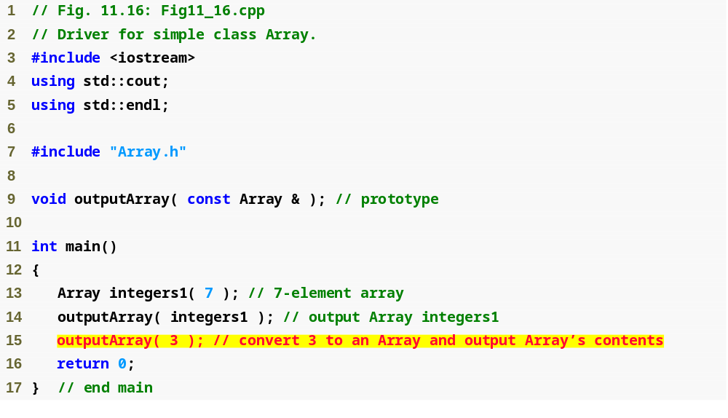
Example 5
convConstError.cpp
(1 of 2)
Would logically want this to generate an error

Slide 25
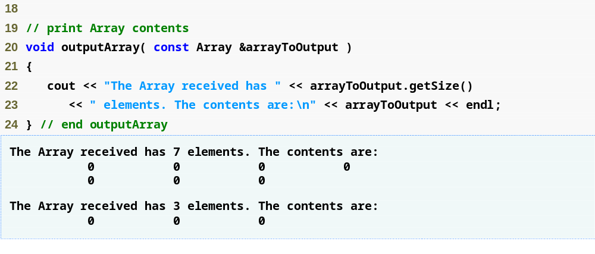
Example 5
convConstError.cpp
(2 of 2)

Slide 26
explicit Constructors
We're going to fix the problem in Example 5 by making our conversion constructor in the Array class explicit
  This means it cannot be implicitly called to do a conversion and can only be called as a regular constructor
Example 6

Slide 27
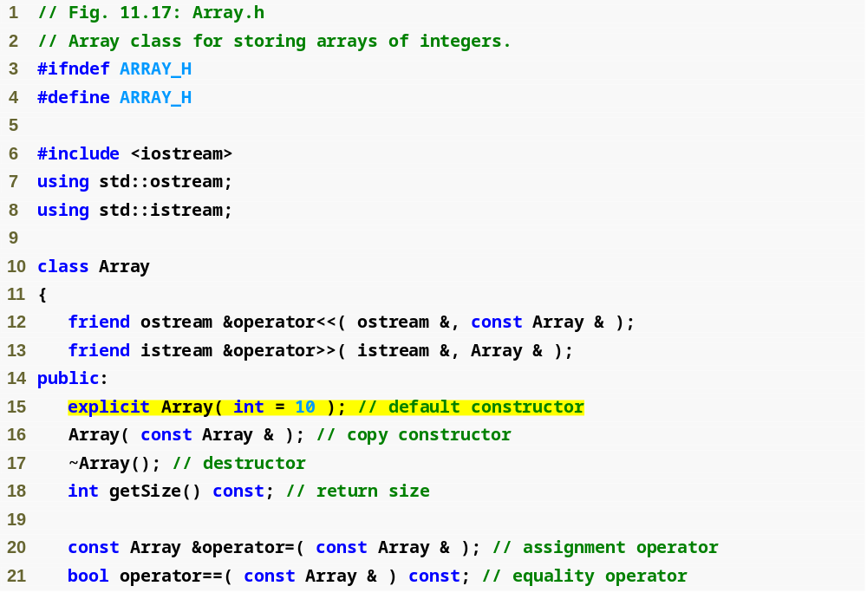
Example 6
Array.h
(1 of 1)
Use explicit keyword to avoid implicit conversions when inappropriate

Slide 28
More on Standard Library Class string
C++ library Class string (Cont.)
  Substring member function substr
    s1.substr( 0, 14 );
      Starts at location 0, gets 14 characters
    s1.substr( 15 );
      Substring beginning at location 15, to the end
  Overloaded []
    Access one character
    No range checking (if subscript invalid)
  Member function at
    Accesses one character
      Example
        s1.at( 10 );
    Has bounds checking, throws an exception if subscript is invalid
      Will end program if invalid (we'll talk more about exception handling in Chapter 16)
Building reusable classes like Array (from earlier) and string (as in the C++ library) can be a lot of work
  HOWEVER: once these classes are perfected and debugged they can be reused by others, other companies, other industries and placed in public or for sale libraries.

Slide 29
Case Study: String Class
Build class String
  String creation, manipulation
  Similar to class string in standard library
Conversion constructor
  Any single-argument constructor is treated as a conversion constructor
    It can be used when any member function in the class needs it, in the case of the String class that means any time a String operation is being done using char* arguments
  Turns objects of other types into class objects
    Example
      String s1( "happy" );
        Creates a String from a char *
    It is also invoked with this statement:
      s1 = "happy"
    It is also invoked when a C-String is passed to a function that expects a String argument or when a C-String is returned from a function with a String return type
Overloading function call operator ()
  Powerful (functions can take arbitrarily long and complex parameter lists)

Slide 30
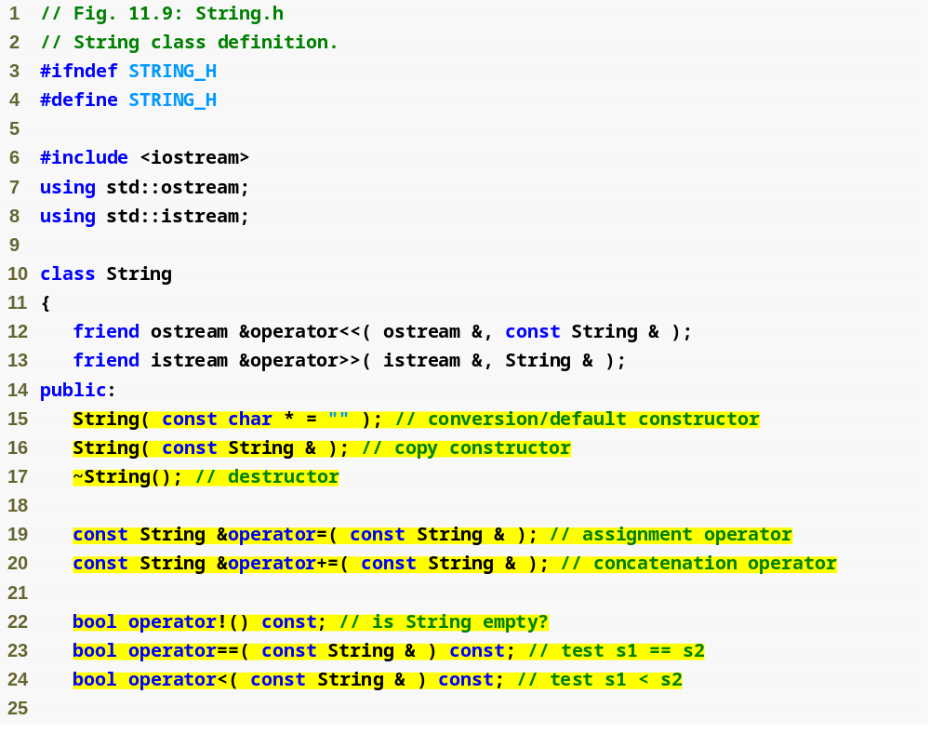
Conversion constructor to make a String from a char *
Example 3
String.h
(1 of 3)
s1 += s2 will be interpreted as s1.operator+=(s2)
Can also concatenate a String and a char * because the compiler will cast the char * argument to a String

Slide 31
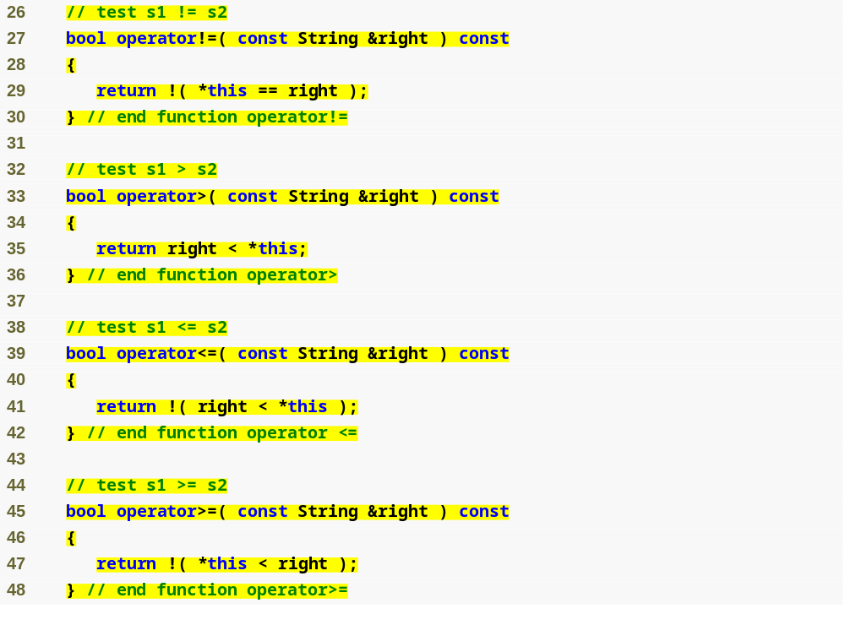
Overload equality and relational operators
Example 3
String.h
(2 of 3)

Slide 32
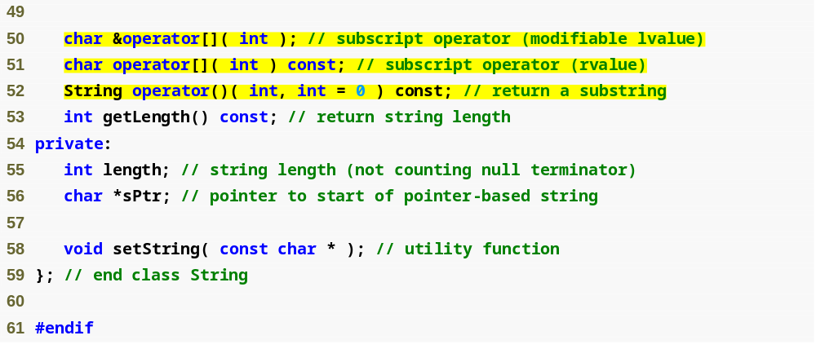
Two overloaded subscript operators, for const and non-const objects
Overload the function call operator () to return a substring
Example 3
String.h
(3 of 3)

Slide 33
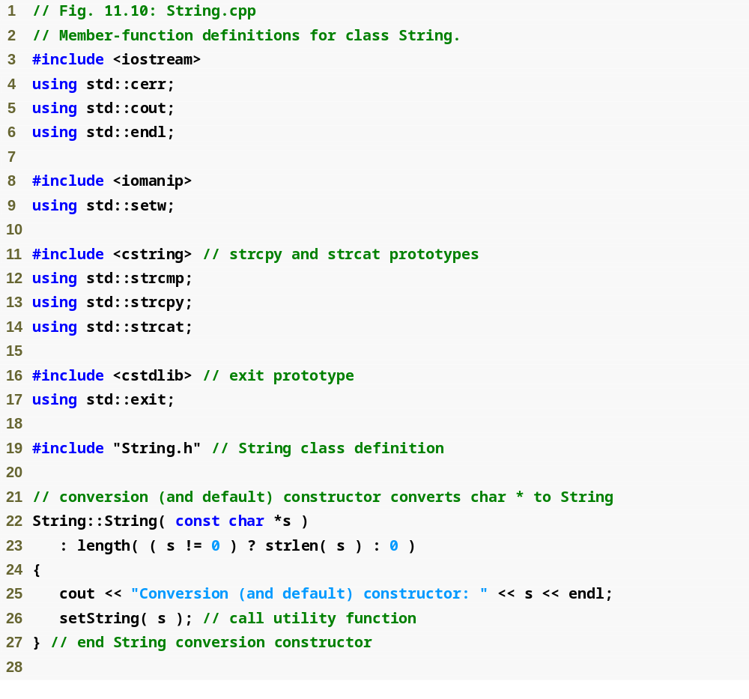
Example 3
String.cpp
(1 of 7)

Slide 34
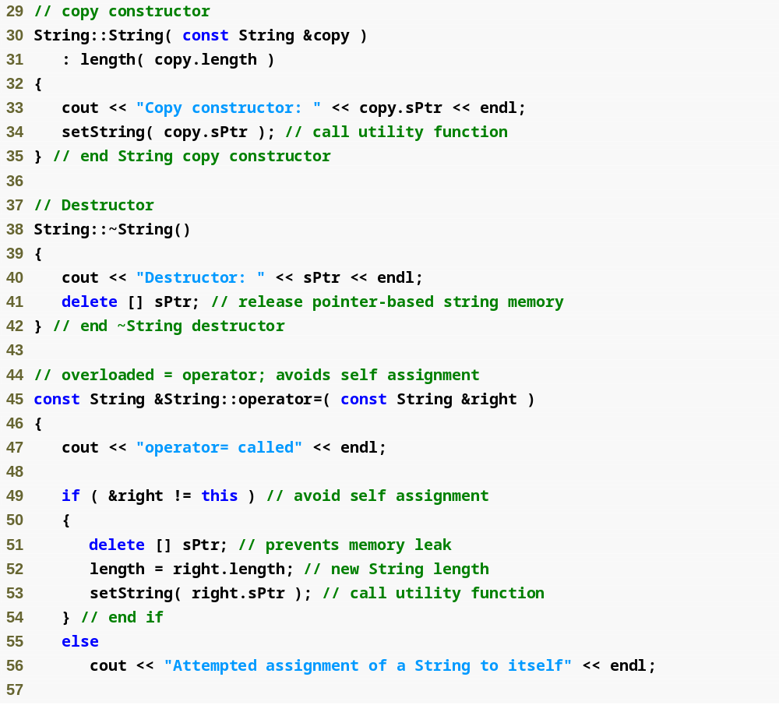
Example 3
String.cpp
(2 of 7)

Slide 35
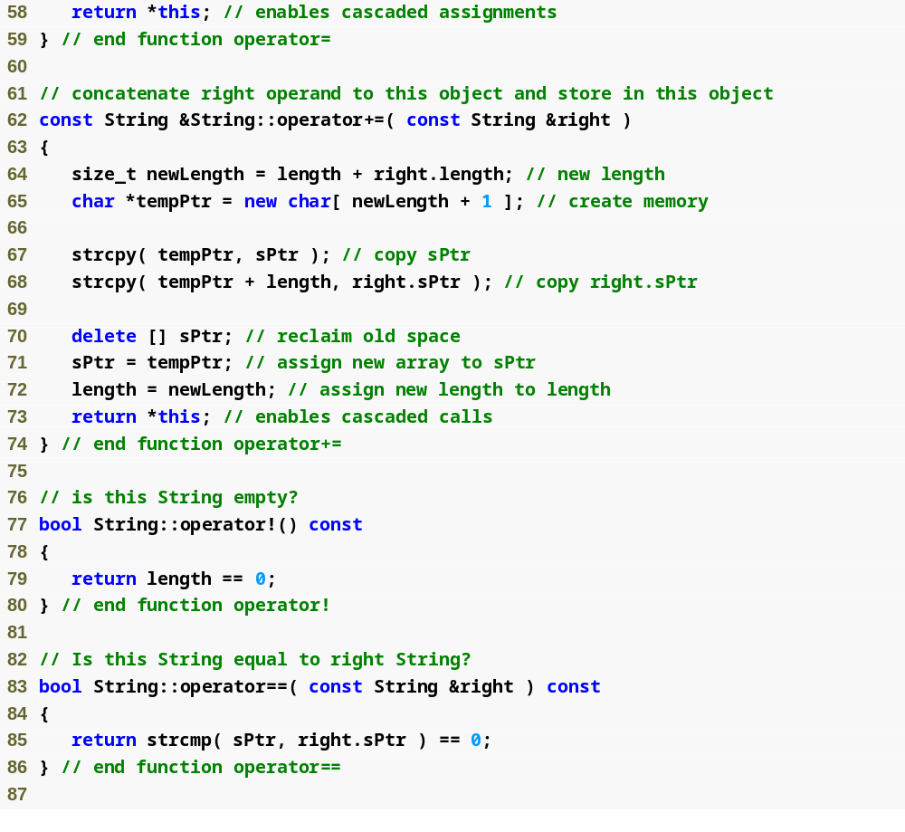
Example 3
String.cpp
(3 of 7)

Slide 36
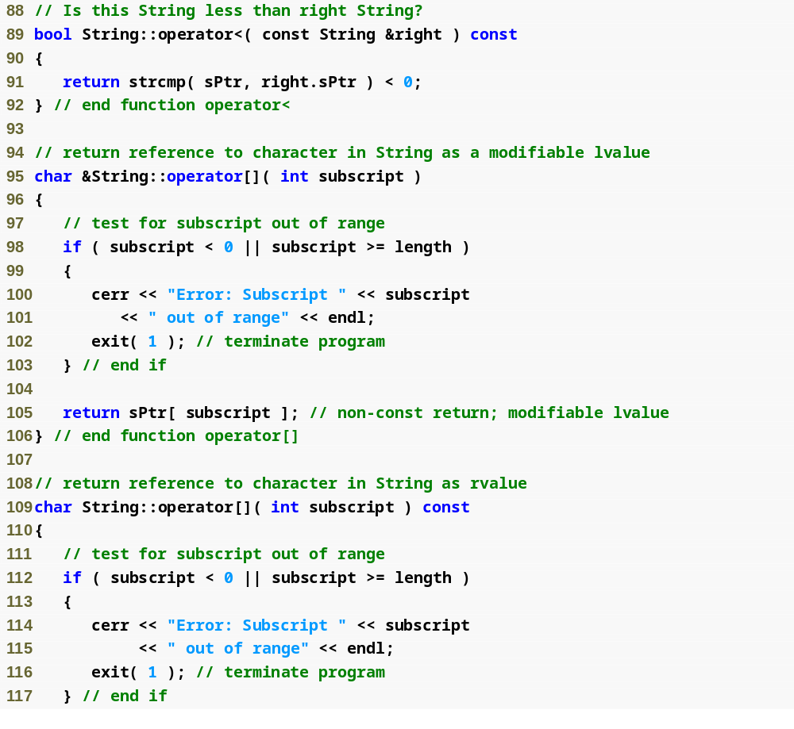
Example 3
String.cpp
(4 of 7)

Slide 37
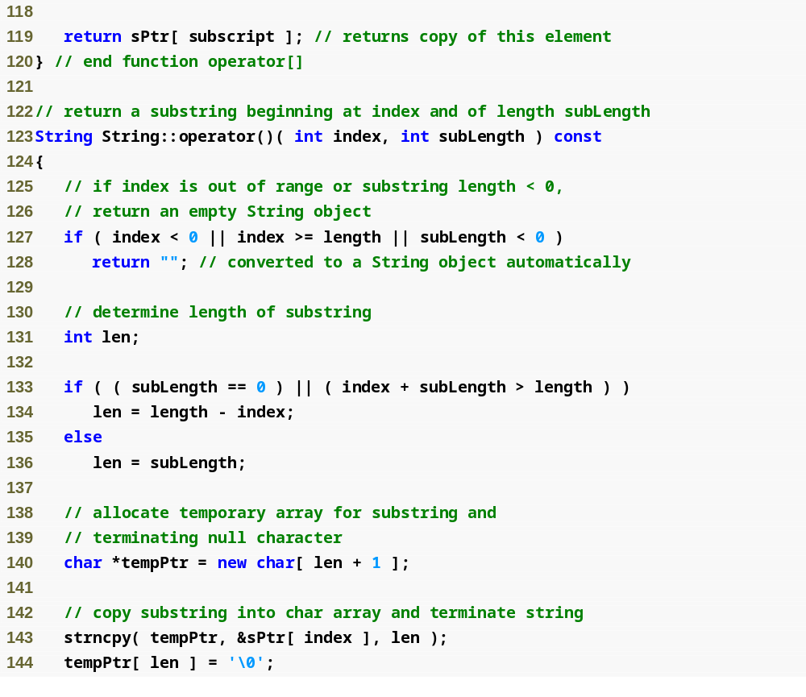
Example 3
String.cpp
(5 of 7)

Slide 38
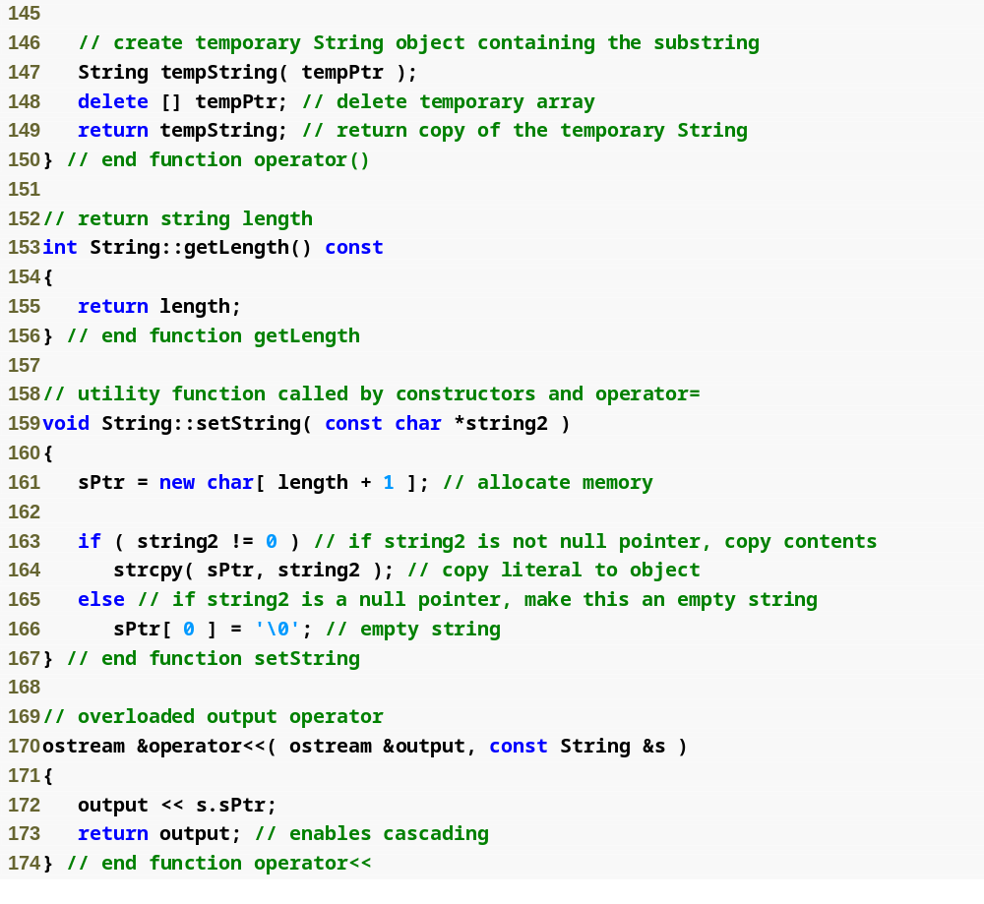
Example 3
String.cpp
(6 of 7)

Slide 39
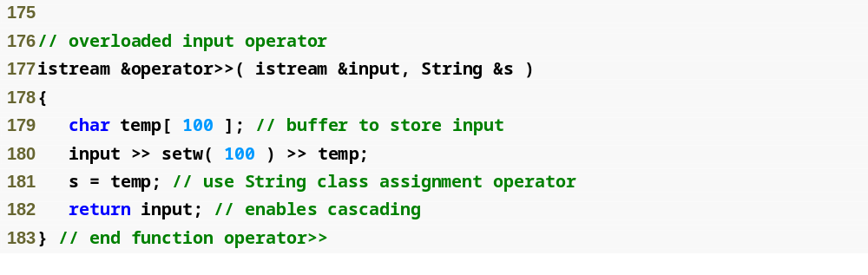
Example 3
String.cpp
(7 of 7)

Slide 40
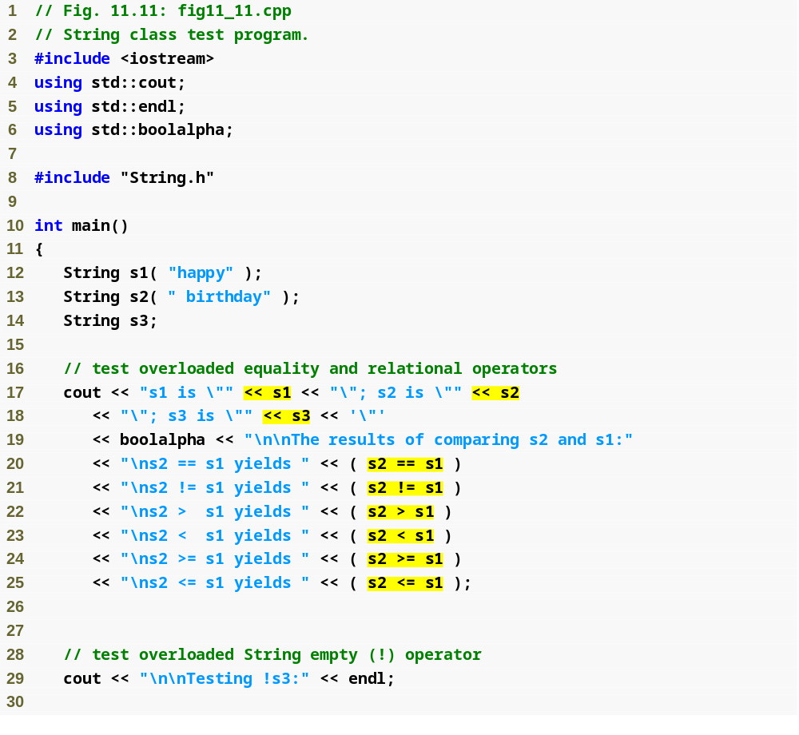
Example 3
stringTest.cpp
(1 of 5)
Use overloaded stream insertion operator for Strings
Use overloaded equality and relational operators for Strings

Slide 41
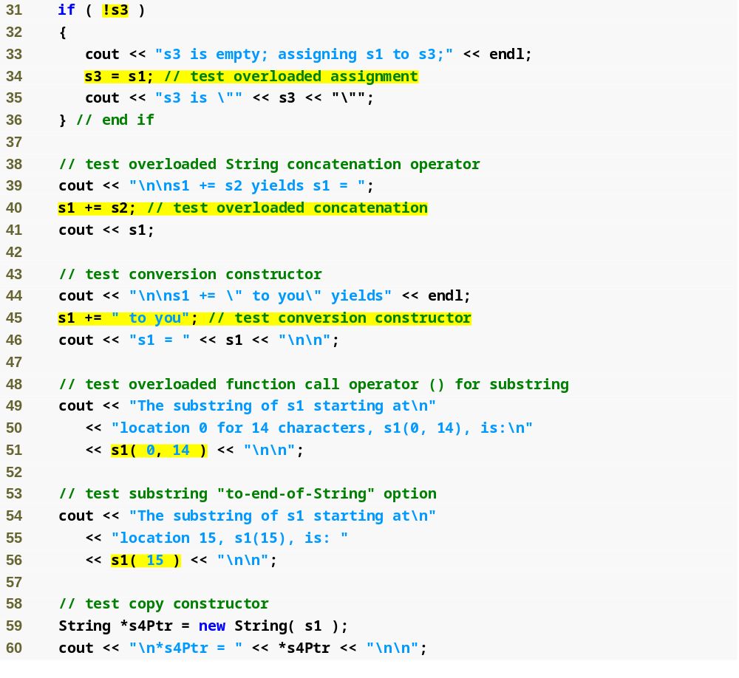
Use overloaded negation operator for Strings
Use overloaded assignment operator for Strings
Example 3
stringTest.cpp
(2 of 5)
Use overloaded addition assignment operator for Strings
char * string is converted to a String before using the overloaded addition assignment operator
Use overloaded function call operator for Strings

Slide 42
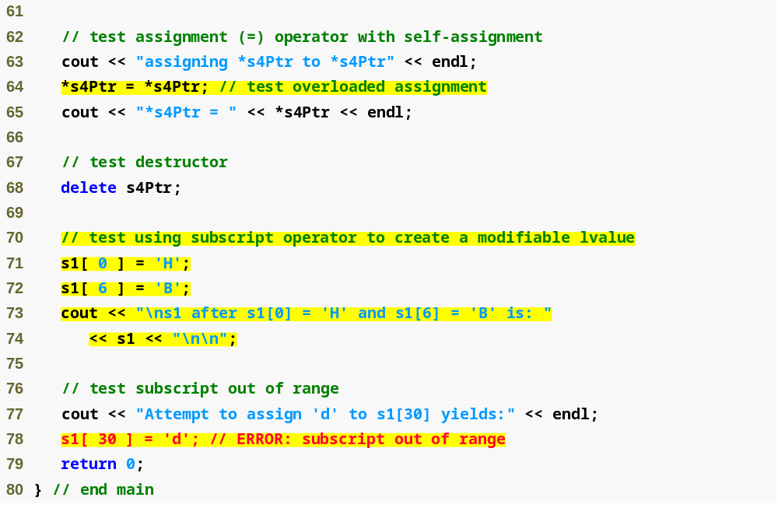
Example 3
stringTest.cpp
(3 of 5)
Use overloaded subscript operator for Strings
Attempt to access a subscript outside of the valid range

Slide 43
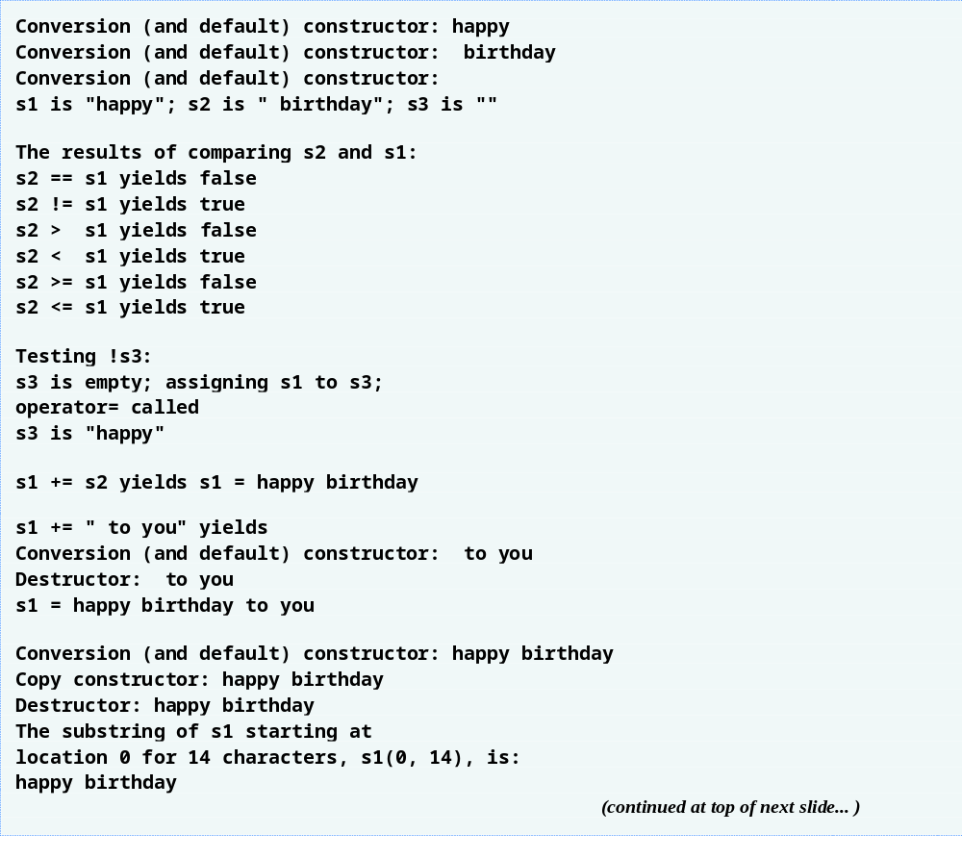
Example 3
stringTest.cpp
(4 of 5)
The constructor and destructor are called for the temporary String

Slide 44
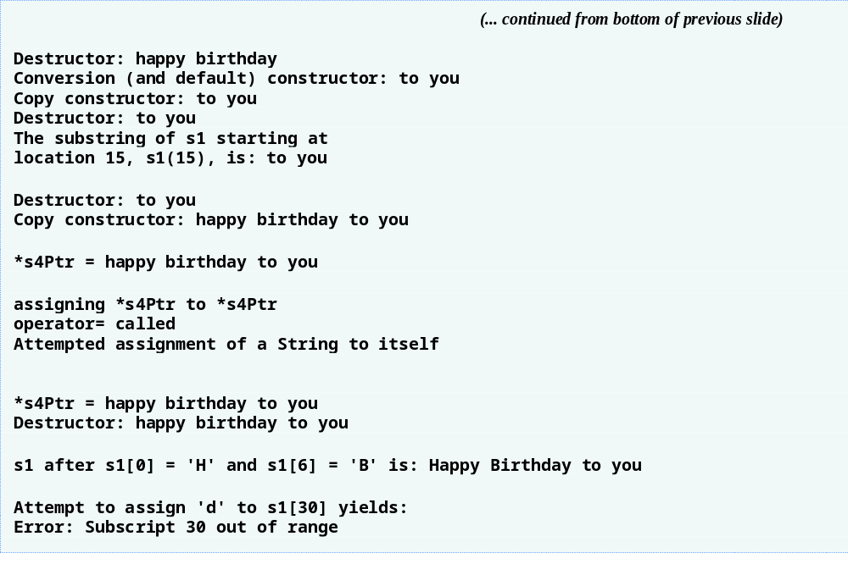
Example 3
stringTest.cpp
(5 of 5)

